Slide 1
MLHC Workshop Final Presentation
Noy Flat - Maya Vishnevsky – Tom Timianker
25/08/2021

Slide 2
Preprocessing
The data we fetched from the DBs is:
Lab tests data
Microbiology labs data
Prescriptions given to the patient
Patient data - gender, age, weight, ethnicity
Constructing the lab results features and grouping the data
kNN imputation
Scaling using standard scalar

Slide 3
Our pipeline
In each stage of the pipeline a different aspect of the classifier / data processing is considered:
Resampling method for the data
Feature selection
Hyper parameters tuning
At each stage we compared the different method and chose the one that maximized the AUPRC for each of the possible classifiers.
Notes:
Lead to AdaCost – task A
Random Forest task B

Slide 4
AdaCost
A variation of AdaBoost.
Give different costs to different misclassification errors.
At each round, the weight updating rule increases the weights of costly wrong classifications (in our case - FN) more aggressively but decreases the weights of costly correct classifications (in our case - TP) more conservatively.
This corresponds to the fact we prefer a patient who’s not suffering from bacterial infection will be treated with antibiotics rather than the opposite.

Slide 5
Resampling
Naïve up sampling
Down sampling
NCL (Neighborhood Cleaning Rule)
SMOTE (Synthetic Minority Oversampling TEchnique)
Combinations: Down sampling & SMOTE, NCL & SMOTE
For both tasks the chosen method was Down sampling & SMOTE
Notes:
NCL (Neighborhood Cleaning Rule) - computes 3 nearest neighbours for each sample. If the sample belongs to the majority class, and it is misclassified by its 3 nearest neighbours, then it is removed. If it belongs to the minority class, and it is misclassified by its 3 nearest neighbours then the majority class examples among those neighbours are removed.
SMOTE (Synthetic Minority Oversampling TEchnique) – The minority class is over sampled by taking each minority class sample and introducing synthetic examples along the line segments joining its k minority class nearest neighbours. This approach effectively forces the decision region of the minority class to become more general.
NCL & SMOTE - NCL should be performed before SMOTE, because SMOTE changes the k nearest neighbors of the samples which might add noise to the down sampling process in NCL.
down sampling & SMOTE - Random down sampling should be performed before SMOTE because SMOTE gets an argument which indicates what is the desired label ratio and down sampling before SMOTE might bring us close to this ratio without introducing synthetic samples.

Slide 6
Resampling - LHO-LOO
Leave half* of majority observations out and one minority observation out at random and then merging the rest of the majority and minority samples to generate one subsampling.
* Tuned
Notes:
The importance of slightly under sampling the minority group is achieving stable variable selection; the selected variables may change significantly due to the influence of a single observation.
This method is used with boosting algorithms such as random forest.

Slide 7
Feature selection
Recursive feature elimination.
Permutation importance based (deleting correlated features).
Average over different folds.

Slide 8
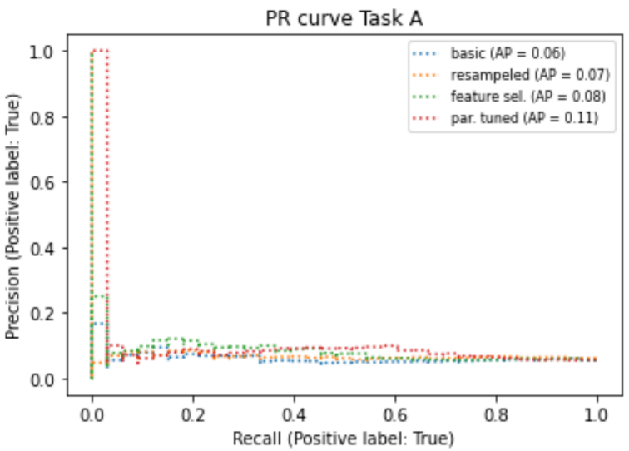
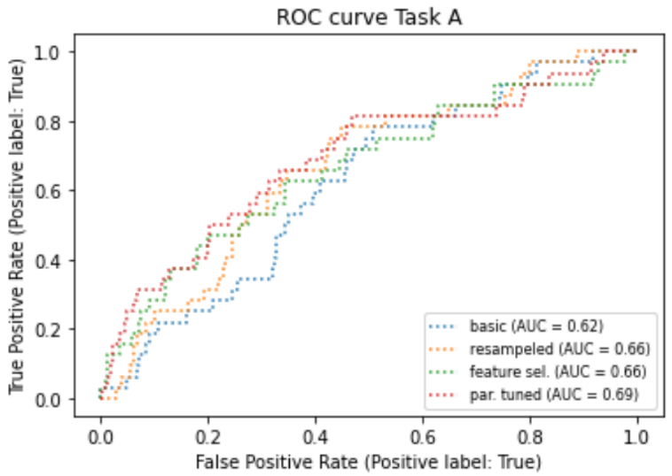
Task A – MIMIC train, MIMIC validation

Slide 9
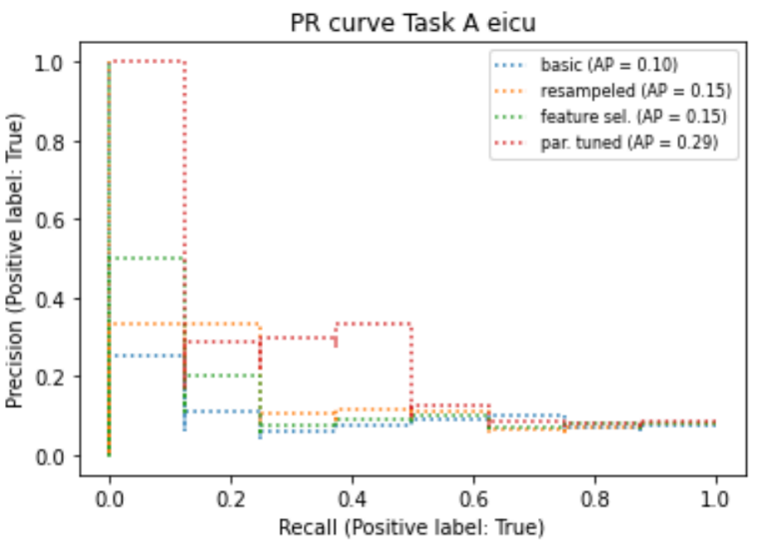
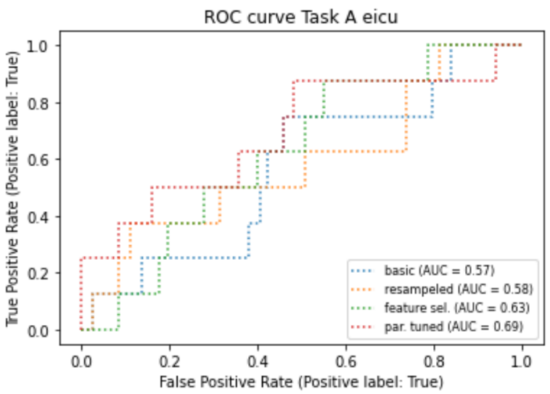
Task A – MIMIC train, eICU validation

Slide 10
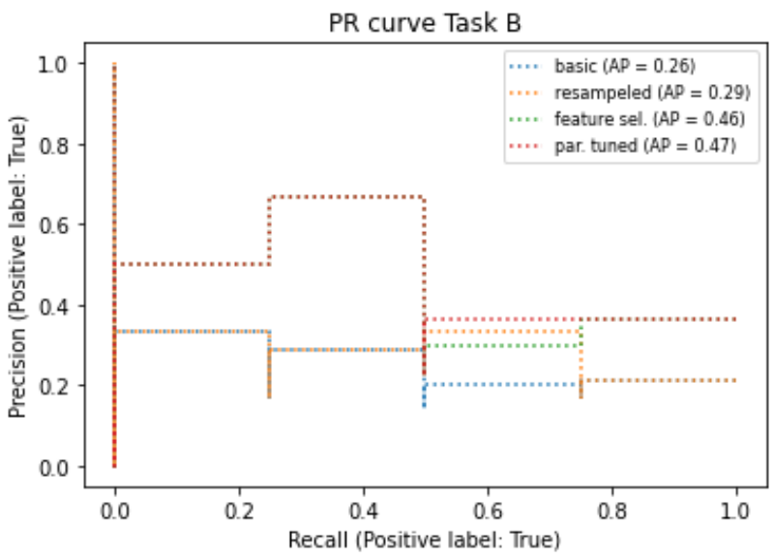
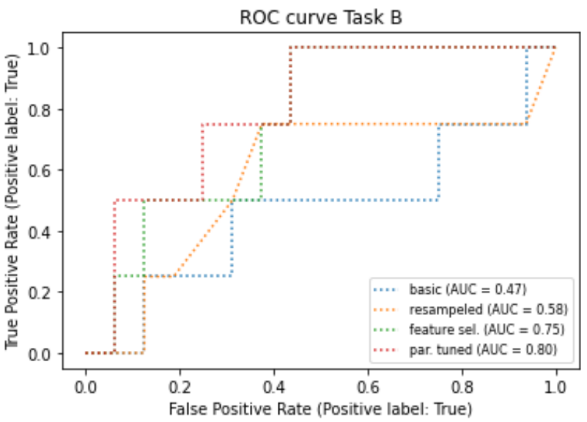
Task B – MIMIC train, MIMIC validation

